Slide 1
Car Accident Severity Prediction
Team 4 (Ian, Jayda, Phoebe)

Slide 2
Table of Contents
01
02
03
04
Data Preparation & EDA
Motivation
Models
Conclusion

Slide 3
01
Motivation

Slide 4

Reduce Accidents
Reducing traffic accidents is always an important challenge
Focus on preventing potential unsafe road conditions from occurring
We might be able to implement well-informed actions and better allocate financial and human resources
Notes:
Reducing traffic accidents, especially serious accidents, is always an important challenge. One of the two main approaches for dealing with traffic safety problems, focuses on preventing potential unsafe road conditions from occurring in the first place. For the effective implementation of this approach, accident prediction and severity prediction are critical. If we can identify the patterns of how these serious accidents happen and the key factors, we might be able to implement well-informed actions and better allocate financial and human resources.

Slide 5
Problem Definition
What factors would affect severity of car accidents?

Slide 6
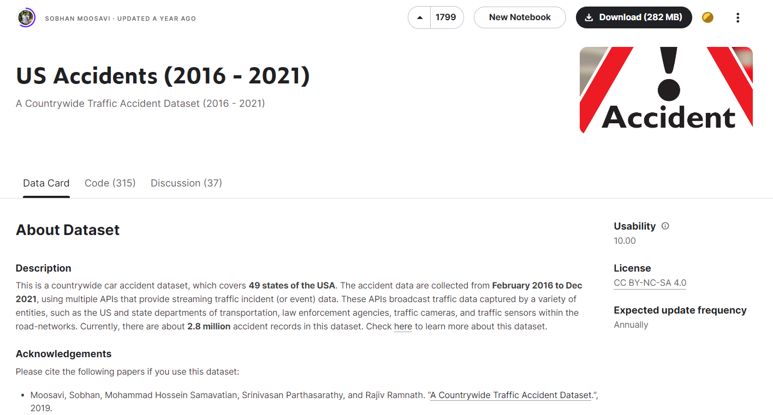
Notes:
Our dataset was taken from Kaggle containing USA car accident data that were accumulated from February 2016 to December 2021 in over 49 states. It originally had 2 million rows which we cut down to 250,000 for faster processing and analysis.
Our focus will be understanding which factors will help us in the prediction of the accident severity (Major or Minor) so we will not be taking into account any specific USA location data such as County and State.

Slide 7
02
Data Preparation
& EDA
Notes:
We will begin our analysis with data pre-processing and exploratory data analysis also known as EDA

Slide 8
DATA PRE-PROCESSING
Drop NA Rows
Balance Dataset
Remove Unwanted
columns
Handle missing data
Minor accidents close to double of Major accidents
Undersampled Major accidents so we can get a balanced distribution
Categorised Severity
Drop 'ID', 'Start_Lat', 'Start_Lng', 'End_Lat', 'End_Lng', 'Distance(mi)', 'Description', 'Number', 'Street', 'City', 'Zipcode','Country', 'State', 'Timezone', 'Airport_Code', 'End_Time'
Classified ‘Severity’ into Major and Minor accidents
More Minor accidents compared to Major
Notes:
First, we removed unwanted columns that we did not want to consider for the analysis. Secondly, we handled missing data by dropping all NA rows
Third, we categorised severity into major and minor and found out there are way more minor accidents than major
so lastly, we used a technique called undersampling to get a balanced distribution

Slide 9
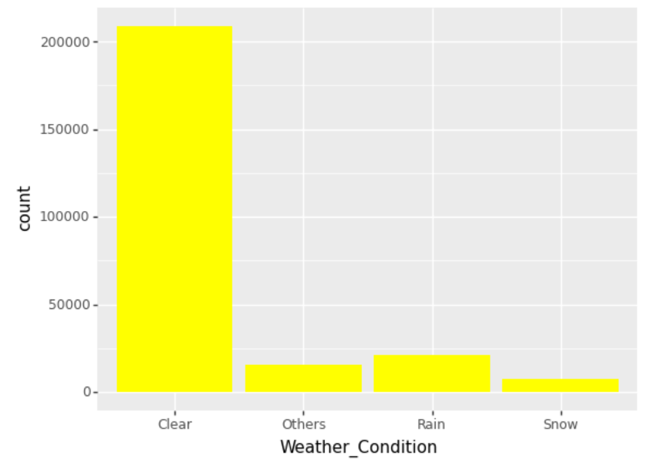
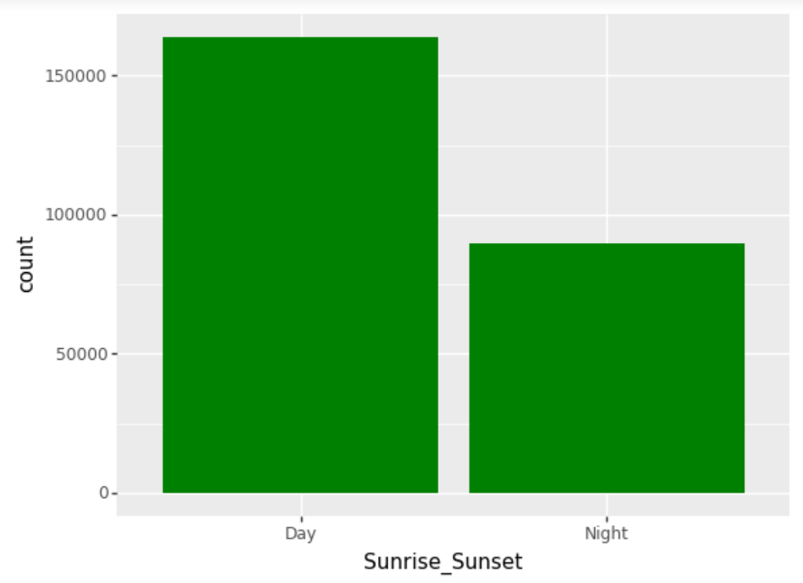
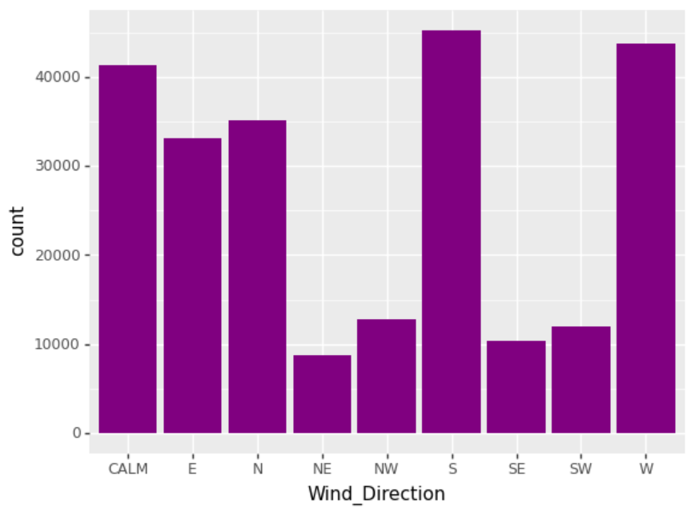
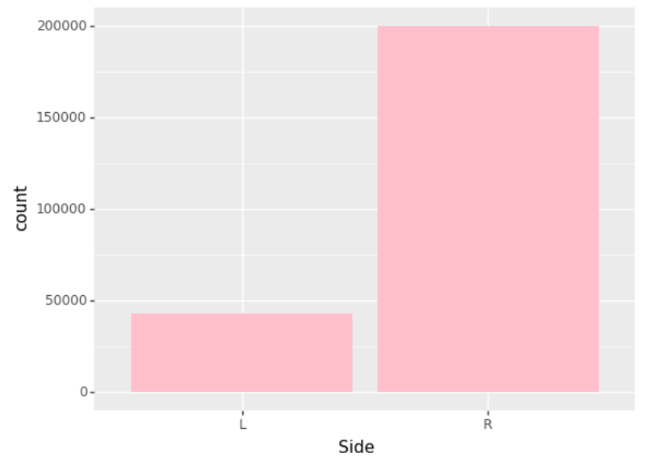
EDA - Barplots
Used Plotly a new visualization library
Notes:
It is unexpected for most cases like for weather condition, most accidents happen even when the weather conditions are good and clear
And more accidents happen when during the day even though we expected that more accidents would happen at night when drivers vision may not be clear
Also there are as many accidents happening when the there is no wind direction as when there is wind direction but we will continue to explore more
It is expected for majority of the accidents to happen on the right lane as in the US, merging lane is tricky, it’s common for people to be focused on making their exit that they forget to look for other cars around them.

Slide 10
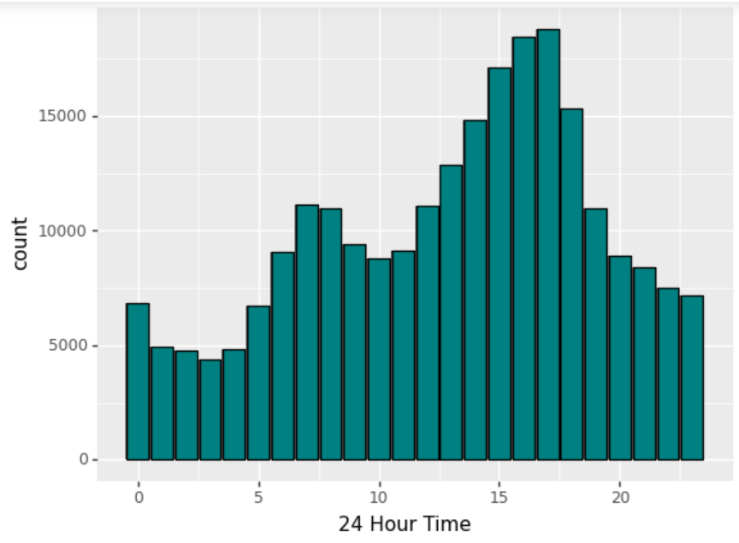
EDA - Start Time Analysis
There are more accidents happening during the rush hours (Morning and Late Afternoon)
Larger number of people travelling to office or home

Slide 11
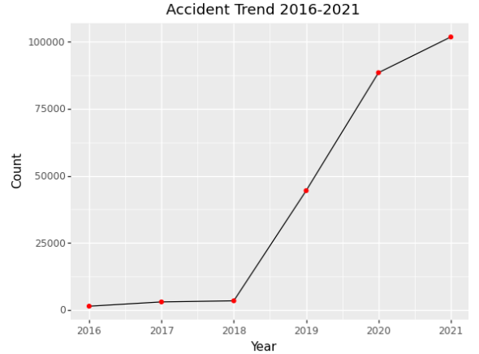
EDA - Accident Trend Analysis
Increasing amount of drivers and autonomous vehicles
Notes:
There was a spike in number of accidents happening from 2016 to 2021. This could be due to the increasing amount of drives and autonomous vehicles

Slide 12
CORRELATIONS WITH CATEGORICAL TARGET
Cramer’s V
Point-Biserial
Categorical Variables
Numerical Variables
Notes:
As part of exploratory data analysis, we decided to try something new in the correlation portion as we had a categorical target and they are called cramer’s v as well as point-biserial correlation.

Slide 13
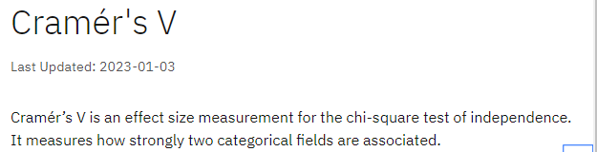
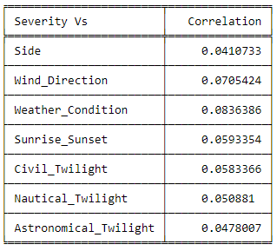
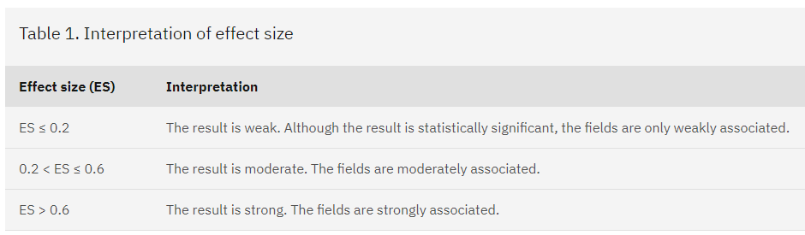
CATEGORICAL CORRELATION
Notes:
Let’s begin with the categorical correlation. Cramer’s V is a method of measurement adapted from chi-squared test to measure the correlations of two categorical variables.
The table below it shows us how to interpret the scores. What we are looking for are strong relations with scores is above 0.6. After performing the test, the scores are shown in the table on the right. all the correlation scores are very very low as they are all almost close to 0. Since the correlations are very weak, or maybe even none at all, we will be moving on to analyse the correlations of numerical variables in our point biserial correlations

Slide 14
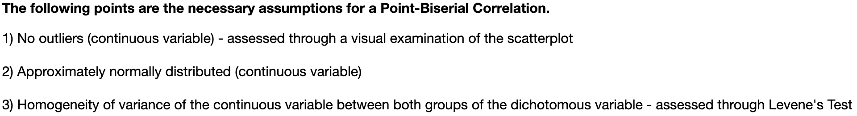
NUMERICAL CORRELATION
Notes:
For our numerical variables, we have decided to learn something new and use the Point-Biserial Correlation. This is because this form of Pearson Correlation is able to measure the relationship between a continuous variable and a dichotomous variable.
In this case, the dichotomous variable in question is “Severity”, which we have separated into “Minor” and “Major” groups.
However, there are 3 necessary assumptions that we need to explore before conducting the Point-Biserial Correlation. As you can see from the slide…

Slide 15
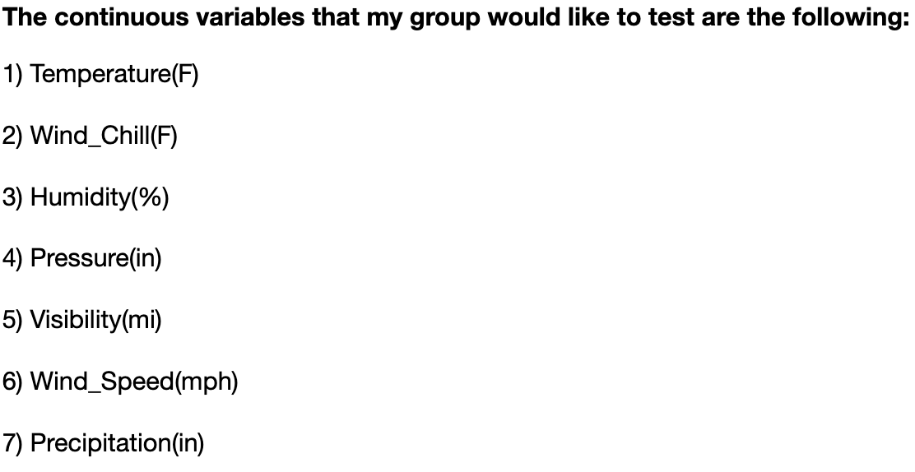
NUMERICAL CORRELATION
Levene test is the second highest at 1.97e-23(3s.f)
No normal distribution curve after outlier removal.
Too many outliers
Levene test is the highest at 0.984(3s.f)
Wind_Speed(mph)
PointbiserialrResult(correlation=0.09569379633534321, pvalue=0.0)
Humidity(%)
PointbiserialrResult(correlation=0.01783588075035289, pvalue=1.5854412068440705e-18)

Slide 16
03
Models
Notes:
Now we will be moving on to the models

Slide 17
MODEL TYPES
Since we have a categorical dependent variable, we had to explore 2 new models:
Random Forest Classification
Logistic Regression
Notes:
Since severity is a categorical dependent variable, we are not able to do linear regression therefore we searched for other models that we could train for our prediction. The two that we landed on are Logistic Regression and Random Forest Classification as they allow categorical prediction with numerical variables.

Slide 18
BUT FIRST,
NORMALIZATION
Using Scikit-Learn’s MinMaxScalar Library
Notes:
but first, before we ran the models, we normalized the features to improve the accuracy and stability. This was done with Sciki-Learn’s MinMaxScalar Library.

Slide 19
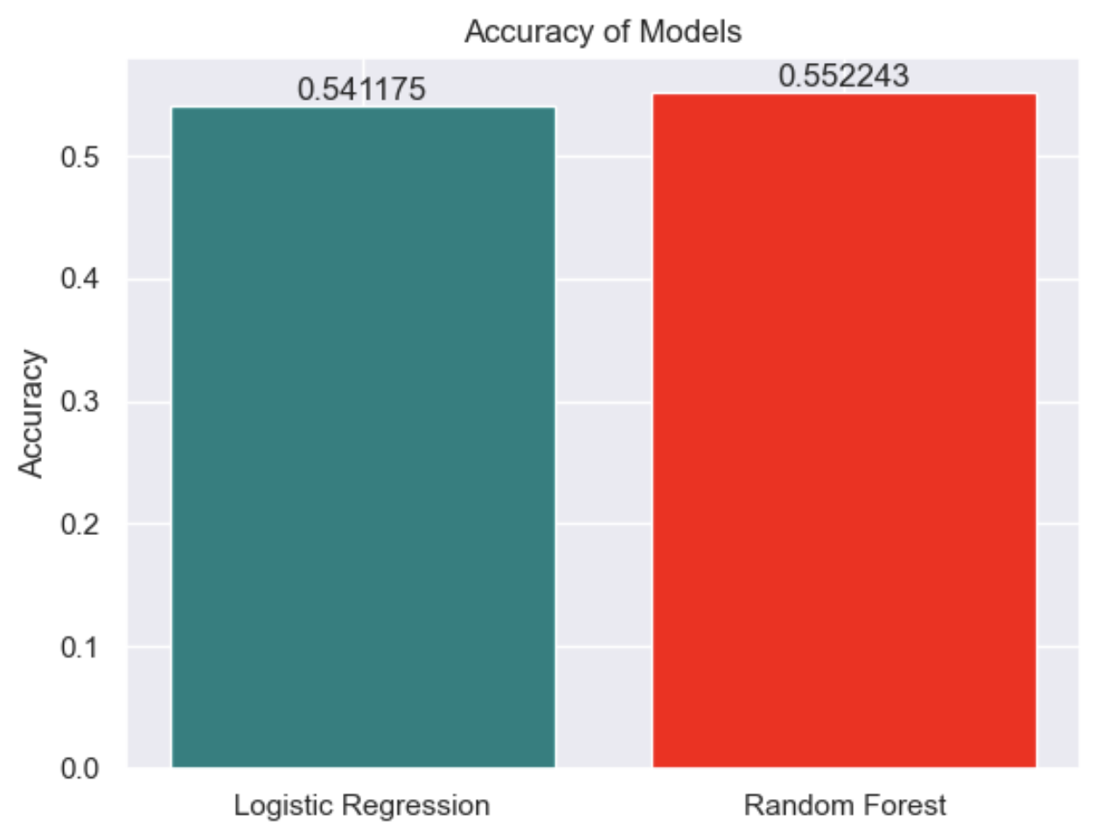
MODEL RESULTS
Notes:
After training the model, here are the results. We used accuracy as a metric for comparison and we can see that both models have relatively high accuracy as it is above 0.5% but here, random forest classification model outperforms the logistic regression model by a small margin.

Slide 20
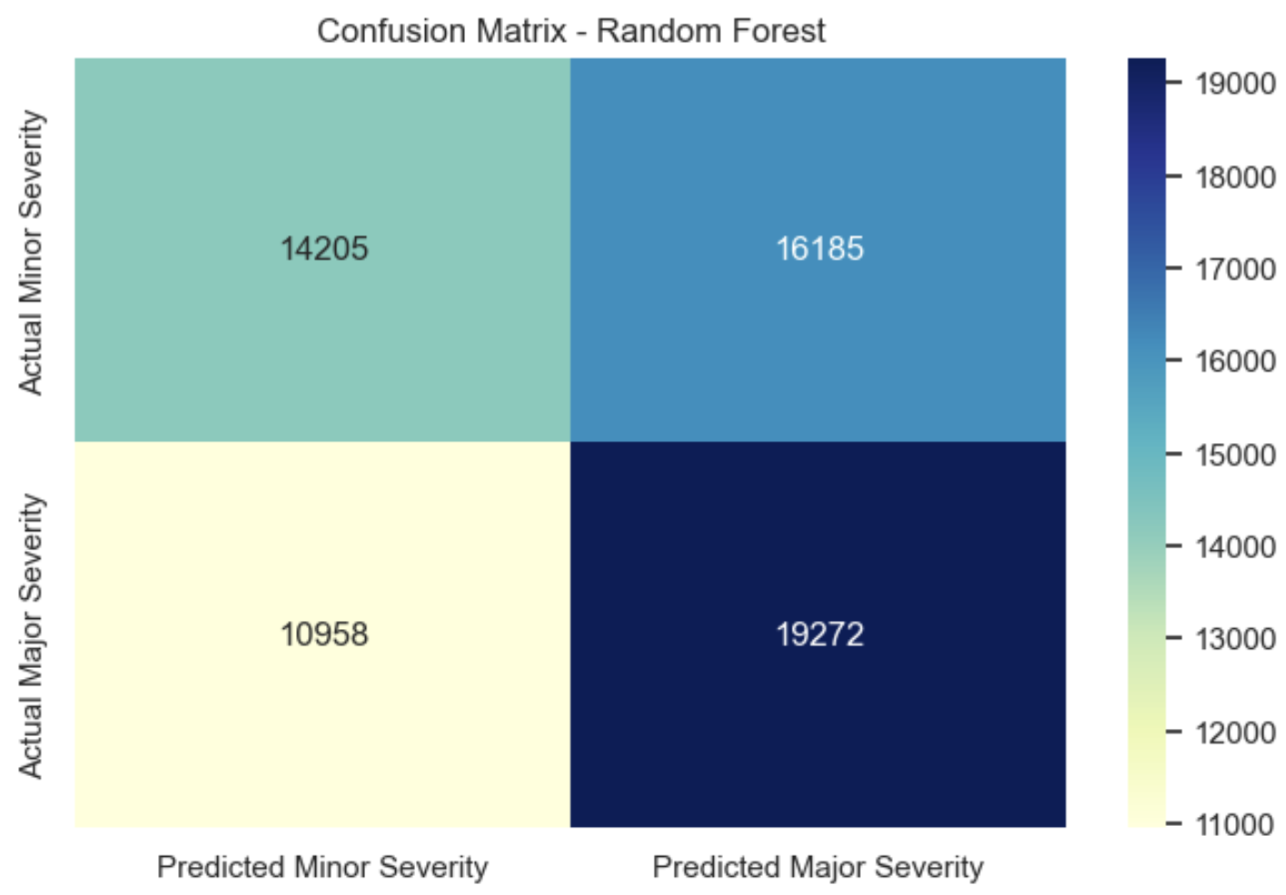
CONFUSION MATRIX
False Positive Rate (FPR): 53.26%
False Negative Rate (FNR): 36.25%
Notes:
However, even though the accuracy is relatively well, the model is not very reliable as we can see from the confusion matrix which shows us that the false positive rate and false negative rates are very high.

Slide 21
INSIGHTS & CONCLUSION
Notes:
We will now move on to the insights and conclusion based on or analysis of the dataset.

Slide 22
DATA-DRIVEN INSIGHTS
Model predicts Major accidents better than Minor accidents but its not reliable
Wind Speeds & Humidity correlates to accidents in general
Notes:
WIND SPEED
Trucks and other vehicles with a high profile are typically more susceptible to high winds, causing them to become overturned on highways and cause an accident. You've probably noticed the situation on the highway when a sudden gust of wind crosses the highway and larger trucks suddenly weave in their lane. If you are next to a semi truck when this happens, you may find yourself in a perilous situation.
People who do not drive high profile vehicles must also be prepared for accidents which they could become involved in due to big rigs and semi-trucks around them. An estimated 423 people die every year during collisions between cars and semi-trucks, according to the National Highway Safety Administration.
HUMIDITY
Cold air holds less water than warm air, and is more oxygen dense. What this means is that warm air requires your engine to pull more air to get the oxygen your engine needs to perform at its best. While this doesn’t have a big effect on your fuel economy, it does put stress on your engine. Stressing out your engine can resulting in a shorter lifespan and more frequent repairs.
Humidity can also impact sensors in your vehicle. Some report their traction control light or check engine light coming on during the more humid time of year and turning off once the air dries out. It’s important to get a diagnostic run when a light comes on, but keep in mind that the weather can cause a false trigger of certain sensors.

Slide 23
Recommendations
Wind Speed
Humidity
Be aware of high-profile vehicles
Keep a distance from vehicles
Watch the weather
Regular maintenance
Install dehumidifiers
Notes:
1Watch the weather
Weather service offices may issue high-wind watches, warnings, or advisories when winds will make it difficult to drive. Expect winds to be worse in exposed places, such as straight, open roads, bridges and overpasses, or between hills.
2Be aware of high-profile vehicles
Large trucks, vans, buses, and those towing cargo, are vulnerable to losing control or tipping over in high winds. They can also create turbulence for motorcycles and other small vehicles. Drivers should pay extra attention to the road and anticipate gusts in windy conditions.
3Keep your distance
Maintain a safe distance from other vehicles to give yourself and other motorists time and space to avoid any debris in the road. Turn on your headlights to see better through dust, dirt, or snow that the wind kicks up.
1. REGULAR MAINTENANCE
Following your routine maintenance schedule will enable you to correct any minor issues before they can evolve into major ones. Even topping off the fluids in your vehicle before summer can stave off most problems through the hotter months.
2. DEHUMIDIFY
Even in a shaded garage, humidity might still be a problem. Removing that humid air from your storage area is key. A dehumidifier works well in smaller spaces, and properly constructed and insulated exterior walls will reduce the level of indoor humidity.

Slide 24
Resources
https://www.ibm.com/docs/en/cognos-analytics/11.1.0?topic=terms-cramrs-v
https://www.cmslaw.com/blog/2021/march/high-winds-can-pose-dangers-for-road-travel/
https://www.bramanminiofmiami.com/blog/2020/july/24/10-tips-to-protect-your-car-from-extreme-heat-humidity.htm
https://www.tdi.texas.gov/tips/safety/driving-windy.html
Notes:
Here are our resources used

Slide 25
Thank you!
Drive Safe!
Notes:
Thank you for listening to our presentation!

